Slide 1
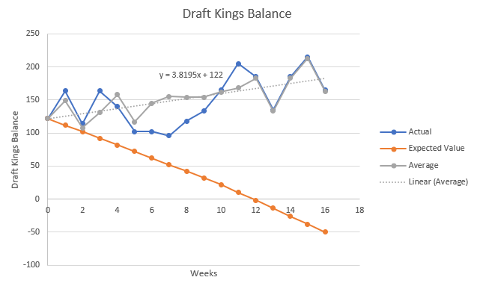
Weekly Progress

Slide 2
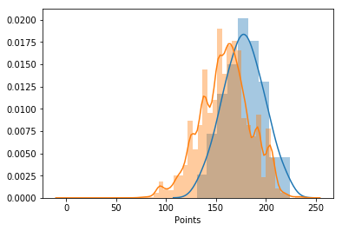
Week 1
NFL Massive $5 Double-Up
10 Entries
75%, won 9/10 ($40)
Starting Balance: $122
After Betting: $74 ($2 bonus for entering)
After Winning: $164

Slide 3
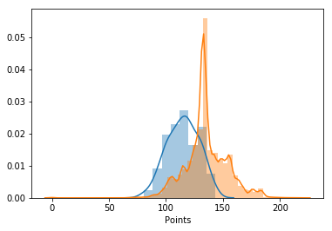
Week 2
NFL Massive $5 Double-Up
10 Entries
7%, won 0/10 ($-50)
Starting Balance: $164
After Betting: $114
After Winning: $114
Rather peaky indicates very similar lineups across competitors

Slide 4
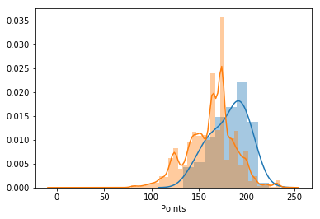
Week 3
NFL Massive $5 Double-Up
10 Entries
71%, won 10/10 ($50)
Starting Balance: $114
After Betting: $64
After Winning: $164

Slide 5
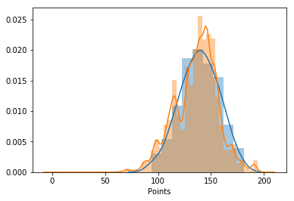
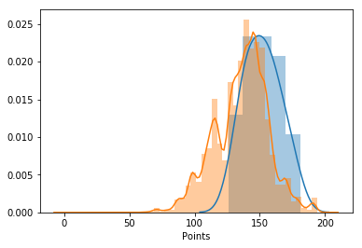
Week 4
NFL Massive $5 Double-Up
10 Entries
48%, won 2/10 ($20)
Starting Balance: $170
After Betting: $120
After Winning: $140
Including Terry McLaurin 48%
Without Terry McLaurin 75%
*Missed that Terry McLaurin was ruled out which screwed me out of some money

Slide 6
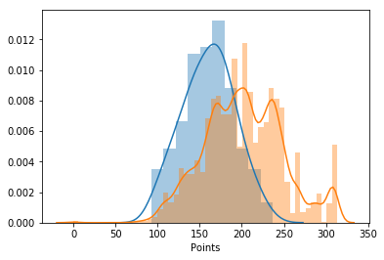
Week 5
NFL Massive $5 Double-Up
10 Entries
7%, won 1/10 ($20)
Starting Balance: $140
After Betting: $90
After Winning: $102

Slide 7
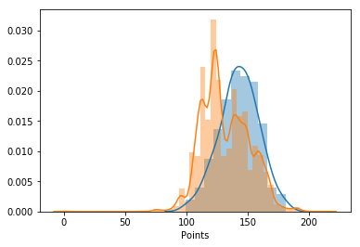
Week 6
NFL Massive $5 Double-Up
10 Entries
76%, won 5/10 ($50)
Starting Balance: $102
After Betting: $52
After Winning: $102

Slide 8
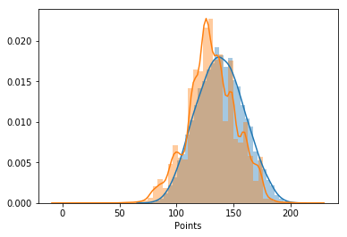
Week 7
NFL Massive $5 Double-Up
10 Entries
58%, won 5/10 ($50)
Starting Balance: $104
After Betting: $54
After Winning: $96

Slide 9
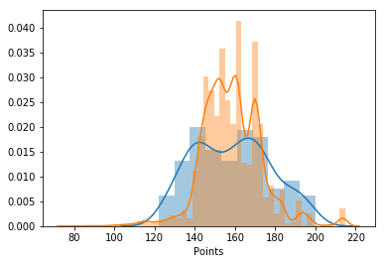
Week 8
NFL Massive $5 Double-Up
10 Entries
47%, won 7/10 ($50)
Starting Balance: $96
After Betting: $46
After Winning: $118

Slide 10
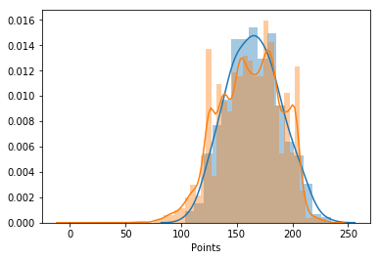
Week 9
NFL Massive $5 Double-Up
10 Entries
45%, won 6/10 ($60)
Starting Balance: $118
After Betting: $68
After Winning: $133
Won $3 extra using free tickets accumulated over the course of this year
￼

Slide 11
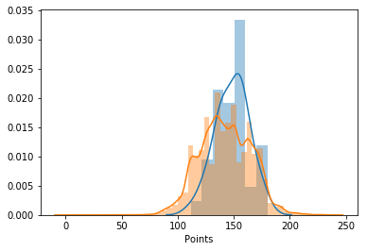
Week 10
NFL Massive $5 Double-Up
10 Entries
58%, won 8/10 ($80)
Starting Balance: $133
After Betting: $83
After Winning: $165
￼

Slide 12
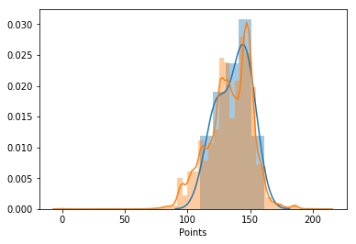
Week 11
NFL Massive $5 Double-Up
10 Entries
56%, won 9/10 ($90)
Starting Balance: $165
After Betting: $115
After Winning: $205
￼

Slide 13
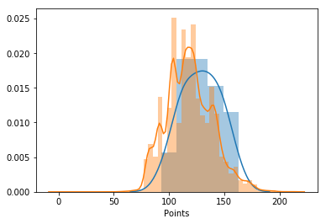
Week 12
NFL Massive $5 Double-Up
10 Entries
64.9%, won 3/10 ($90)
Starting Balance: $205
After Betting: $155
After Winning: $185
￼
￼

Slide 14
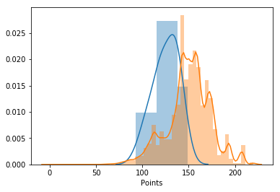
Week 13
NFL Massive $5 Double-Up
10 Entries
0%, won 0/10 ($0)
Starting Balance: $185
After Betting: $135
After Winning: $135
￼
￼
￼

Slide 15
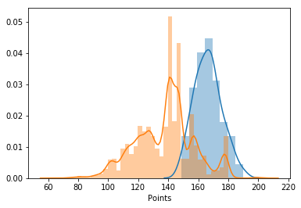
Week 14
NFL Massive $5 Double-Up
10 Entries
100%, won 10/10 ($100)
Starting Balance: $135
After Betting: $85
After Winning: $185
￼
￼

Slide 16
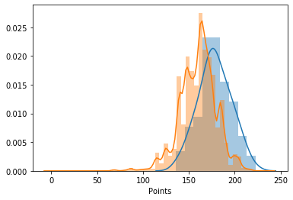
Week 15
NFL Massive $5 Double-Up
10 Entries
80%, won 8/10 ($100)
Starting Balance: $185
After Betting: $35
After Winning: $215
￼
￼

Slide 17
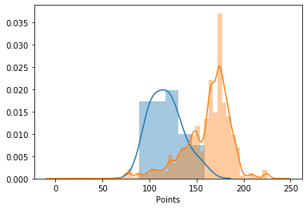
Week 16
NFL Massive $5 Double-Up
10 Entries
0%, won 0/10 ($100)
Starting Balance: $215
After Betting: $165
After Winning: $165
￼
￼

